Slide 1
Todd Wold twold@education.ucsb.edu Ed.D. candidate 2011
Space
Technology
and Robotic
Systems
Curriculum, Collaboration, Challenges

Slide 2
The Fifth Discipline: The art of practice of the learning organization
“A shared vision is not an idea. It is not even an important idea such as freedom. It is, rather, a force in people’s hearts, a force of impressive power. It may be inspired by an idea, but once it goes further—if it is compelling enough to acquire the support of more than one person—then it is no longer an abstraction. It is palpable. People begin to see it as if it exists. Few, if any, forces in human affairs are as powerful as shared vision.” (Senge, 1990, p.192)

Slide 3
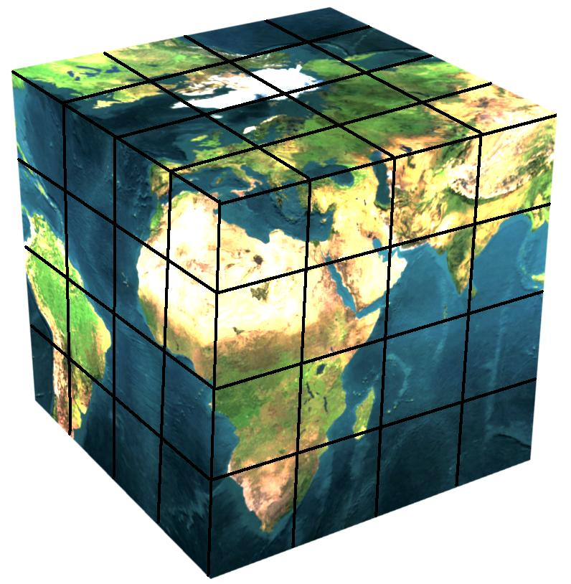
What is our 4x4x4 matrix?
Grade
Subject
Renewable Energy

Slide 4
CURRICULUM
Space
Technology
and Robotic
Systems
Curriculum, Collaboration, Challenges

Slide 5
Leadership and the New Science: Discovering order in a chaotic world
“In a field view of organizations, we attend first to clarity…and then we must make certain that everyone has access to this field…vision statements move off the walls and into the corridors…in the past we may have thought of ourselves as skilled designers of organizations, assembling the pieces…we need all of us out there, stating, clarifying, reflecting, modeling…if we do…a powerful field develops—and with it, the wondrous capacity to organize into coherent, capable form.” (Wheatley, 2006, p.56)

Slide 6
Wind Energy
 | English | Mathematics | Science | Elective
9th | Autobiographical Narrative “The Boy Who Harnessed the Wind” | Algebra: ManipulatingEquations, Ratios, Graphing, Maximizing (Power, Energy, Force, Ohms Law) | Earth Science: Wind Turbine, What Makes Wind?, Weather Maps | Beginning Drafting: Basic Turbine Design, Gear Ratios, Wind Farm Design

Slide 7
Wind Energy
 | English | Mathematics | Science | Elective
10th | Persuasive Speech Writing and Analysis: Legislation, Environment Tax Breaks, Agriculture, Ecology, Return on Investment | Geometry/ Trigonometry Pythagorean Theorem, Special Triangles, Circles/ Angles of Elevation and Depression, Dilation of Blade Design | Biology: Ecology Projects (Bird & Bat migrations, Bat communication) | Engineering Design: Weightlifting (KidWind lesson 6), Which Blades are Best (KidWind lesson 8), Pitch Analysis, Gear Ratios

Slide 8
Wind Energy
 | English | Mathematics | Science | Elective
11th | Road Trip Nation: Field trip interviews | Algebra II: Exponential Equations, Turbine Power, KE, Probability (Birds and Bats), Conic Sections | Chemistry: Electrons, Storing Wind Energy (Fuel Cell, Battery) | Electronics/ Robotics: Yaw: Servo Motors on Turbine Nacelle (Wind Direction), Electronic Gearing for Wind Speed

Slide 9
Wind Energy
 | English | Mathematics | Science | Elective
12th | Potential Senior Capstone Project | Statistics/ Calculus/ Economics: Power, Exponential Curve Fitting/ Exponential Equations, Volumes of Odd Shapes, Return on Investment | Physics: Law of Conservation of Energy, Kinetic Energy, Potential Energy, Power, Mechanics, Rotational Motion, Electromagnetics, Generators | Advanced CAD/ Manufacturing Analyzing pitch and distance from hub simultaneously “pitchometer”, Carbon Fiber (Advanced materials and molding)

Slide 10
COLLABORATION
Space
Technology
and Robotic
Systems
Curriculum, Collaboration, Challenges

Slide 11
School Reform from the Inside Out: Policies, practice, and performance
“One of the strongest social norms among school faculty is that everyone is expected to pretend that they are equally effective at what they do. Yet, the entire process of improvement depends on schools making public and authoritative distinctions among teachers and administrators based on quality, competence, expertise, and performance. To improve themselves, systems need to be able to identify people who know what to do, to develop the capacity of those in the organization to learn what to do, and to create settings in which people who know what to do teach those that don’t.” (Elmore, 2005, p.122)

Slide 12
Grade Level Collaboration
At each grade level, a teacher from each academy subject area form an Academy Grade Level PLC
Interdisciplinary Mission:
To integrate theme based curriculum horizontally across grade levels.
To utilize grade level appropriate literacy methods (Constructing Meaning) within content area.
To create a greater sense of connection between students and grade level academic course load within the academy.

Slide 13
Subject Area Collaboration
Within each subject area, teachers form an Academy Subject Area PLC
Intradisciplinary Mission:
To vertically integrate theme based curriculum within subject area.
To utilize subject area specific literacy methods (Constructing Meaning) along content area.
To create a greater sense of connection between students and subject area academic course load within the academy.

Slide 14
Integrating Renewable Energy
Academy teachers work in a PLC environment to learn about the theme based curriculum
Renewable Energy Curriculum Mission:
To identify areas that Wind, Solar, Geo, and Bio Energy topics can fit within existing pacing calendars.
To identify literacy needs (Constructing Meaning) associated with renewable energy curriculum.
To create a greater sense of connection between academy faculty and theme based curriculum within the academy.

Slide 15
CHALLENGES
Space
Technology
and Robotic
Systems
Curriculum, Collaboration, Challenges

Slide 16
Challenges
What do we do when classes are not pure academy students?
What if students are not in all four grade level courses?
What if students are on different math tracks?
What if students are new to the academy and their peers had this last year but they didn’t?
How do I “make this fit” my pacing calendar and state standards?

Slide 17
Challenges
I don’t have time to become an expert on Wind, Solar, Geo, and Bio energies.
I don’t think my subject works well with this theme.
I feel like this is putting more work on what I already feel is an overworked schedule. I thought we were supposed to be “doing less….better”.

Slide 18
Organizational Culture and Leadership
“In a rapidly changing world, the learning leader must not only have vision but also be able both to impose it and to evolve it further as external circumstances change…the culture creation leader needs persistence and patience, yet as a leader must be flexible and ready to change. As groups and organizations develop, certain key emotional issue arise: those having to do with dependence on the leader, with peer relationships, and with how to work effectively. Leadership is needed to help the group identify the issue and deal with them. The leader…must provide temporary stability and emotional reassurance while the answer is being worked out. The difficult learning agenda for leaders is how to be simultaneously clear and strong in articulating their vision and yet open to change.” (Schein, 2010, p.374)

Slide 19
SOLUTIONS
Space
Technology
and Robotic
Systems
Curriculum, Collaboration, Challenges

Slide 20
Whatever it Takes: How professional learning communities respond when kids don’t learn
“As educators develop their capacity to function as a PLC, they create a culture that stretches the hopes, aspirations, and performance of students and adults alike. Students are encouraged to stretch beyond their comfort zone and pursue challenging curriculum. Teachers are stretched to develop and implement more effective strategies in their classrooms…a stretch culture rests upon high expectations” (DuFour, 2004, p.179-80)

Slide 21
Solutions
What do we do when classes are not pure academy students?
By looking closely at state standards and pacing calendars, while being open to creative methods of implementation, we are finding ways to integrate our renewable energy themes, regardless of whether students have joined the academy. A positive result is that there are instances when students have joined the academy as they have felt a connection to the academy theme, students, and faculty.

Slide 22
Solutions
What if students are not in all four grade level courses?
Projects implemented by all four teachers as “team teaching” projects have not worked for us for this reason. When we find natural fits for the renewable energy curriculum within each course, though there is a broader connection, there is not a specific connection across courses.

Slide 23
Solutions
What if students are on different math tracks?
Since this vision is truly 4x4x4, even if academy students in a math class are in different English or science classes, they are still being introduced to the renewable energy themes as they apply to that particular course. The same goes for having English students that are at different math level.

Slide 24
Solutions
What if students are new to the academy and their peers had this last year but they didn’t?
Though there is collaboration to build vertically within a subject area, natural fits into existing standards and pacing calendars are not dependant upon the previous year.

Slide 25
Solutions
How do I “make this fit” my pacing calendar and state standards?
Don’t make it fit. Each teacher is a content expert and a professional. Our goal is that after experiencing all three types of collaboration (the 4x4x4) teachers will eventually find natural fits as they intentionally learn more about renewable energy. The renewable energy experts in the academy also look at pacing calendars and standards for subject areas and try to ask questions that might help collaboratively to utilize both sets of expertise to find those natural fits.

Slide 26
Solutions
I don’t have time to become an expert on Wind, Solar, Geo, and Bio energies.
We have renewable energy experts within the academy team that are not subject area experts on how to apply the theme to other subjects. Our renewable energy experts try to look for natural connections and research for resources (such as narratives, speeches, math problems) and propose those to content experts so try and find those natural fits.

Slide 27
Solutions
I don’t think my subject works well with this theme.
Through the collaboration process between subject areas, the goal is to think outside the box and find natural fits. For instance, in the English 10 standards, students analyze and write persuasive speeches. The trick is finding speeches on renewable energy with grade level appropriate vocabulary to analyze while providing resources that students may use to research prior to writing their own persuasive speech.

Slide 28
Solutions
I feel like this is putting more work on what I already feel is an overworked schedule. I thought we were supposed to be “doing less….better”.
The goal is to adhere to the “natural fit” philosophy, while using individual professional expertise to support one another. This PLC process supports one another while maintaining high expectations.

